Slide 1
Week 2
Peer Assisted Learning

Slide 2
Today’s Session
The focus is on:
Determinants
Cramer’s Rule

Slide 3
What is the Determinant?
The determinant is just a number that we can calculate from a square matrix (matrix with same number of rows and columns).
If you would like to know more about the history behind it: History of Matrices
Why do we care about it? They are quite useful in helping us solve a system of linear equations or finding the inverse of a matrix (among other things).

Slide 4
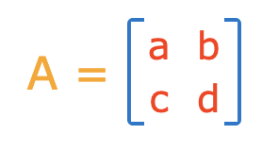
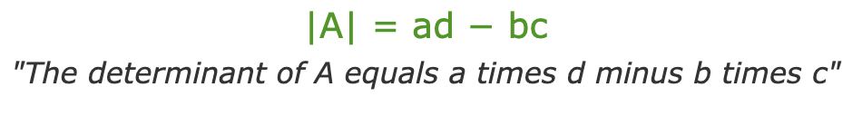
The Determinant of a 2x2 Matrix?

Slide 5
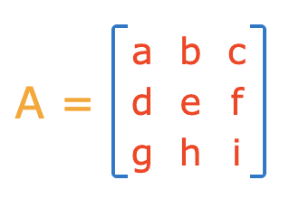
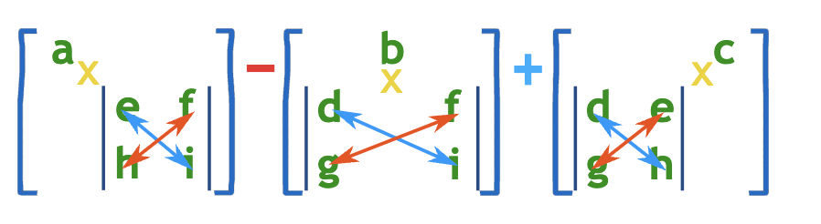
What about the determinant of an nxn matrix?
We can start by looking at a 3x3 matrix:
What is this saying?
Multiply a by the determinant of the 2x2 matrix that is found by ‘removing’ a’s row and column.
Do the same for b and c.
Sum them up, but put a negative in front of the b.
(We chose the top row, does it make a difference?)

Slide 6
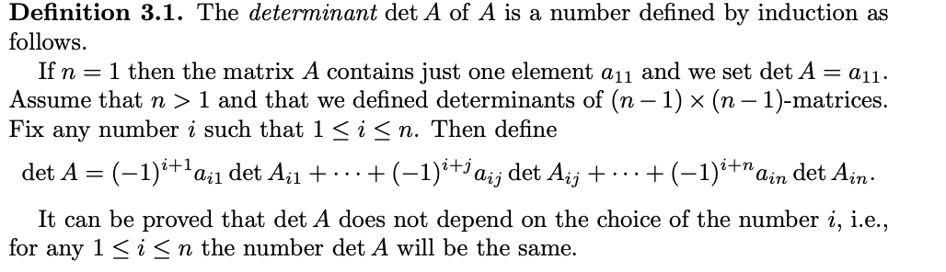
What about the determinant of an nxn matrix?
We can look at the fancy definition, but this is just a formal way of describing what we just did for the 3x3 matrix.

Slide 7
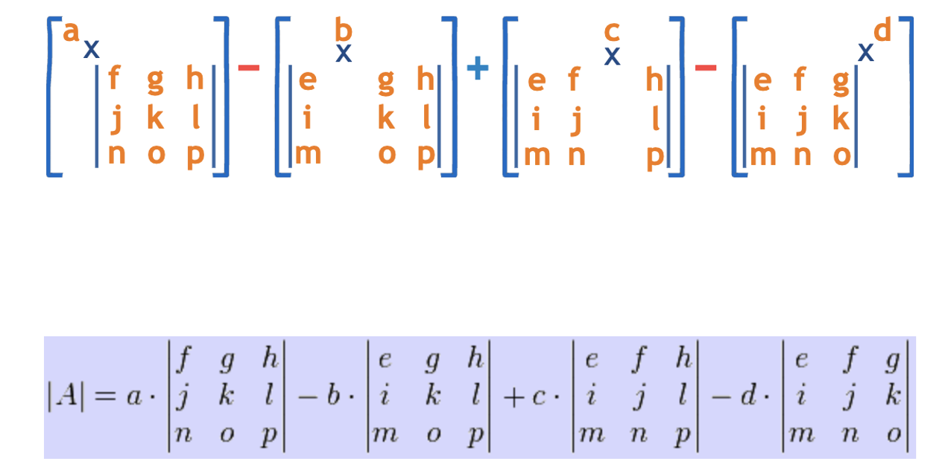
Extra Example: A 4x4 Matrix

Slide 8
Cramer’s Rule
Given a system of linear equations, Cramer’s Rule is a way to solve for just one variable without having to solve for the whole system.
(Of course, for your exams you most likely will be solving for the whole system anyway).

Slide 9
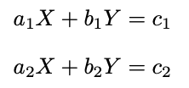
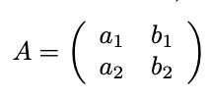
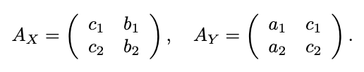
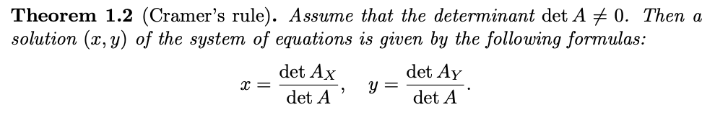
Cramer’s Rule for a 2x2 Matrix (Lecture Notes)
We have a system of linear equations, in this case two. We’re solving for variables X and Y, and the rest are some numbers. We can write three matrices, corresponding to this system:

Slide 10
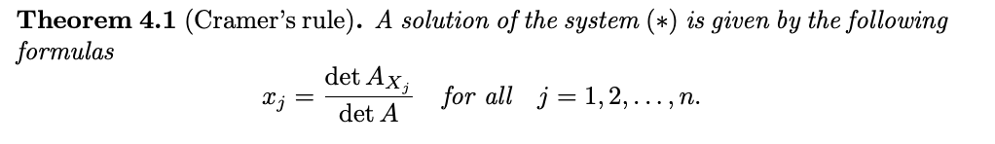
Cramer’s Rule :
We can apply this idea to any square matrix

Slide 11
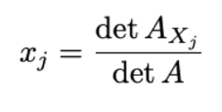
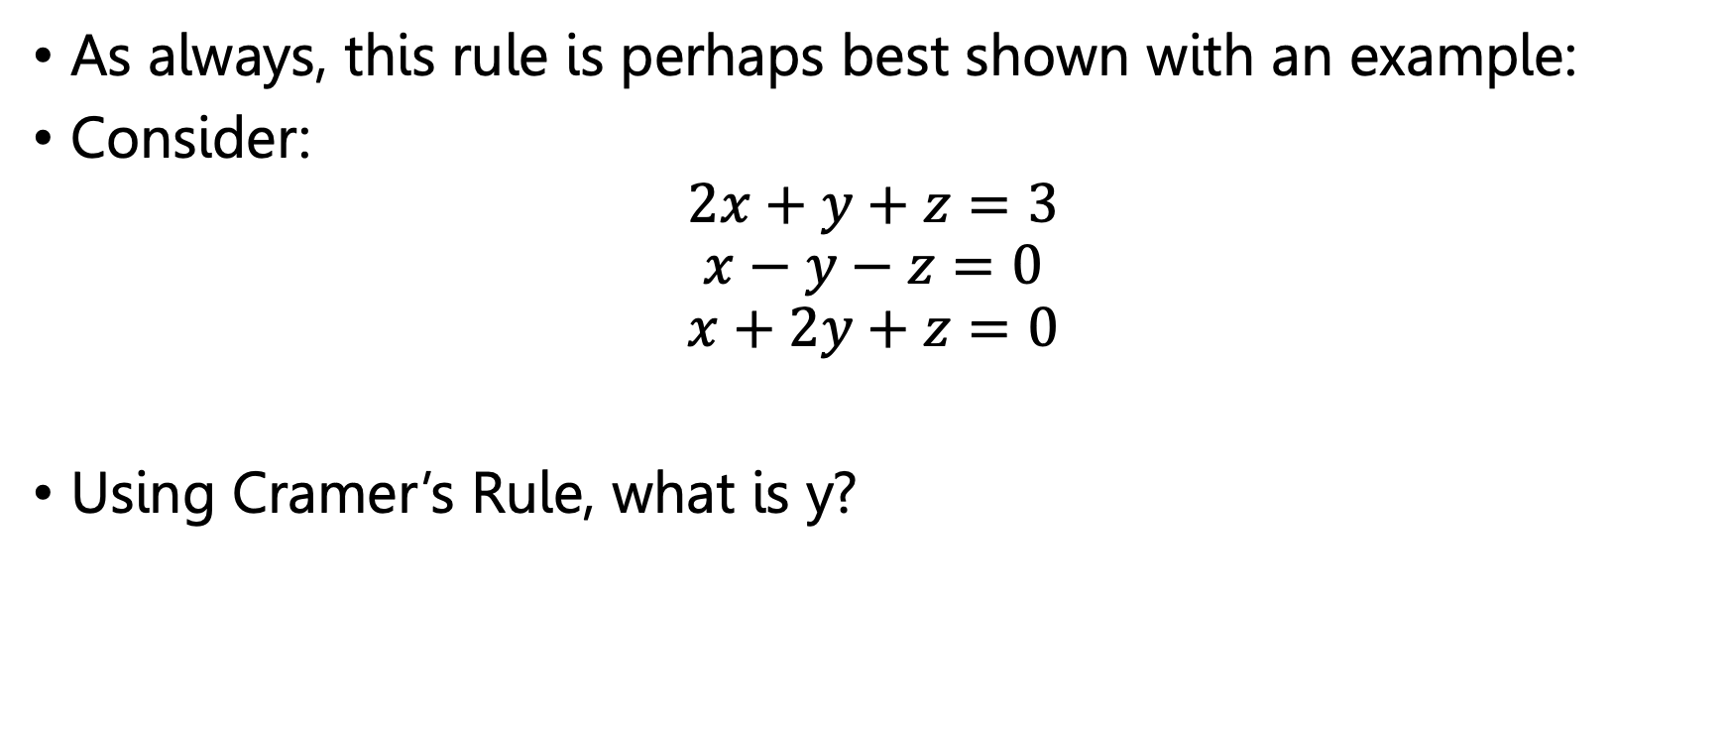
Cramer’s Rule Example:
As always, this rule is perhaps best shown with an example:
Consider:
$$2x+y+z=3$$
$$x−y−z=0$$
$$x+2y+z=0$$
Using Cramer’s Rule, what is y?

Slide 12
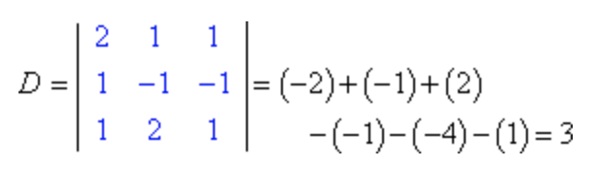
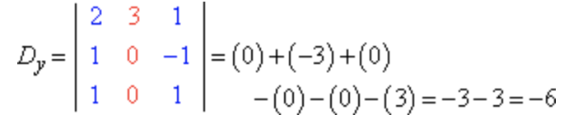
Cramer’s Rule Example:
Y is therefore -6/3 = -2.

Slide 13
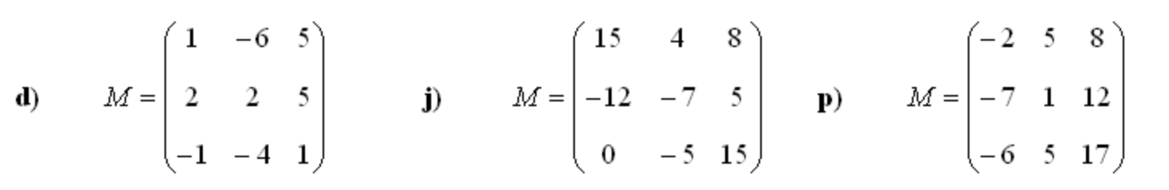
PRACTICE – Find the Determinants:
1. Find the determinants for the following matrices:
2. Solve the following systems of linear equations using Cramer’s Rule:
x + 4 y + 3z = 2
2x − 6 y + 6z = −3
5x − 2 y + 3z = −5
3. Solve the following system of linear equations using Cramer’s Rule:
3x + y + 2z = 3
2x – 3y –z = -3
x +2y +z = 4

Slide 14
Question 1:

Slide 15
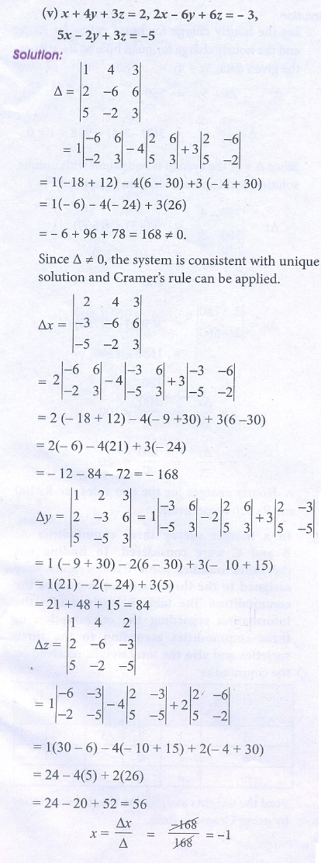
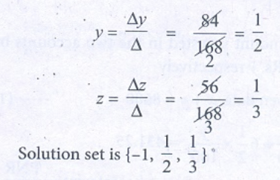
Question 2:

Slide 16
Question 3:
Solved the exam same way as question 2!
X = 1, y = 2, z = -1

